Slide 1

Room Radar
Accommodation Finder
Athipathi Janarth

Slide 2
Problem Statement
Finding off-campus accommodation is a difficult endeavor for college students. There is no suitable website or app for people to utilize to find houses, roommates, or a place to stay temporarily before their long-term apartment move-in date. Most students utilize Facebook groups, WhatsApp, and Telegram, although there are many groups formed and not all students receive the information.

Slide 3
Solution
Building a smartphone application to assist students seeking for both temporary and long-term housing is the goal of this project. Users/Students (hosts) may post their apartments along with the dates they will be open, and students can look for rooms that match their criteria, make reservations for short-term accommodation, or contact the host for long-term residences.

Slide 4
Brief Overview
With their preferences for housemates, apartment photographs, video tour , move-in dates, house rules, nearby stores, hosts will be able to advertise their flats for permanent housing or short-term housing.
Users will be able to find permanent or temporary housing by applying filters based on choices for room type, hall place, members of the house with matching courses, and university.
User’s request will sent to host for approval, host will be able to examine details about the user, including the courses they are enrolled in, their states, their languages, and their contact information.
User’s are able to see other user’s who and all looking for apartments and communicate to them after filtering out according to preferences

Slide 5
Models View Controller (Models)
Models
Users
Rooms
Bookings
Reviews
Users Preferences

Slide 6
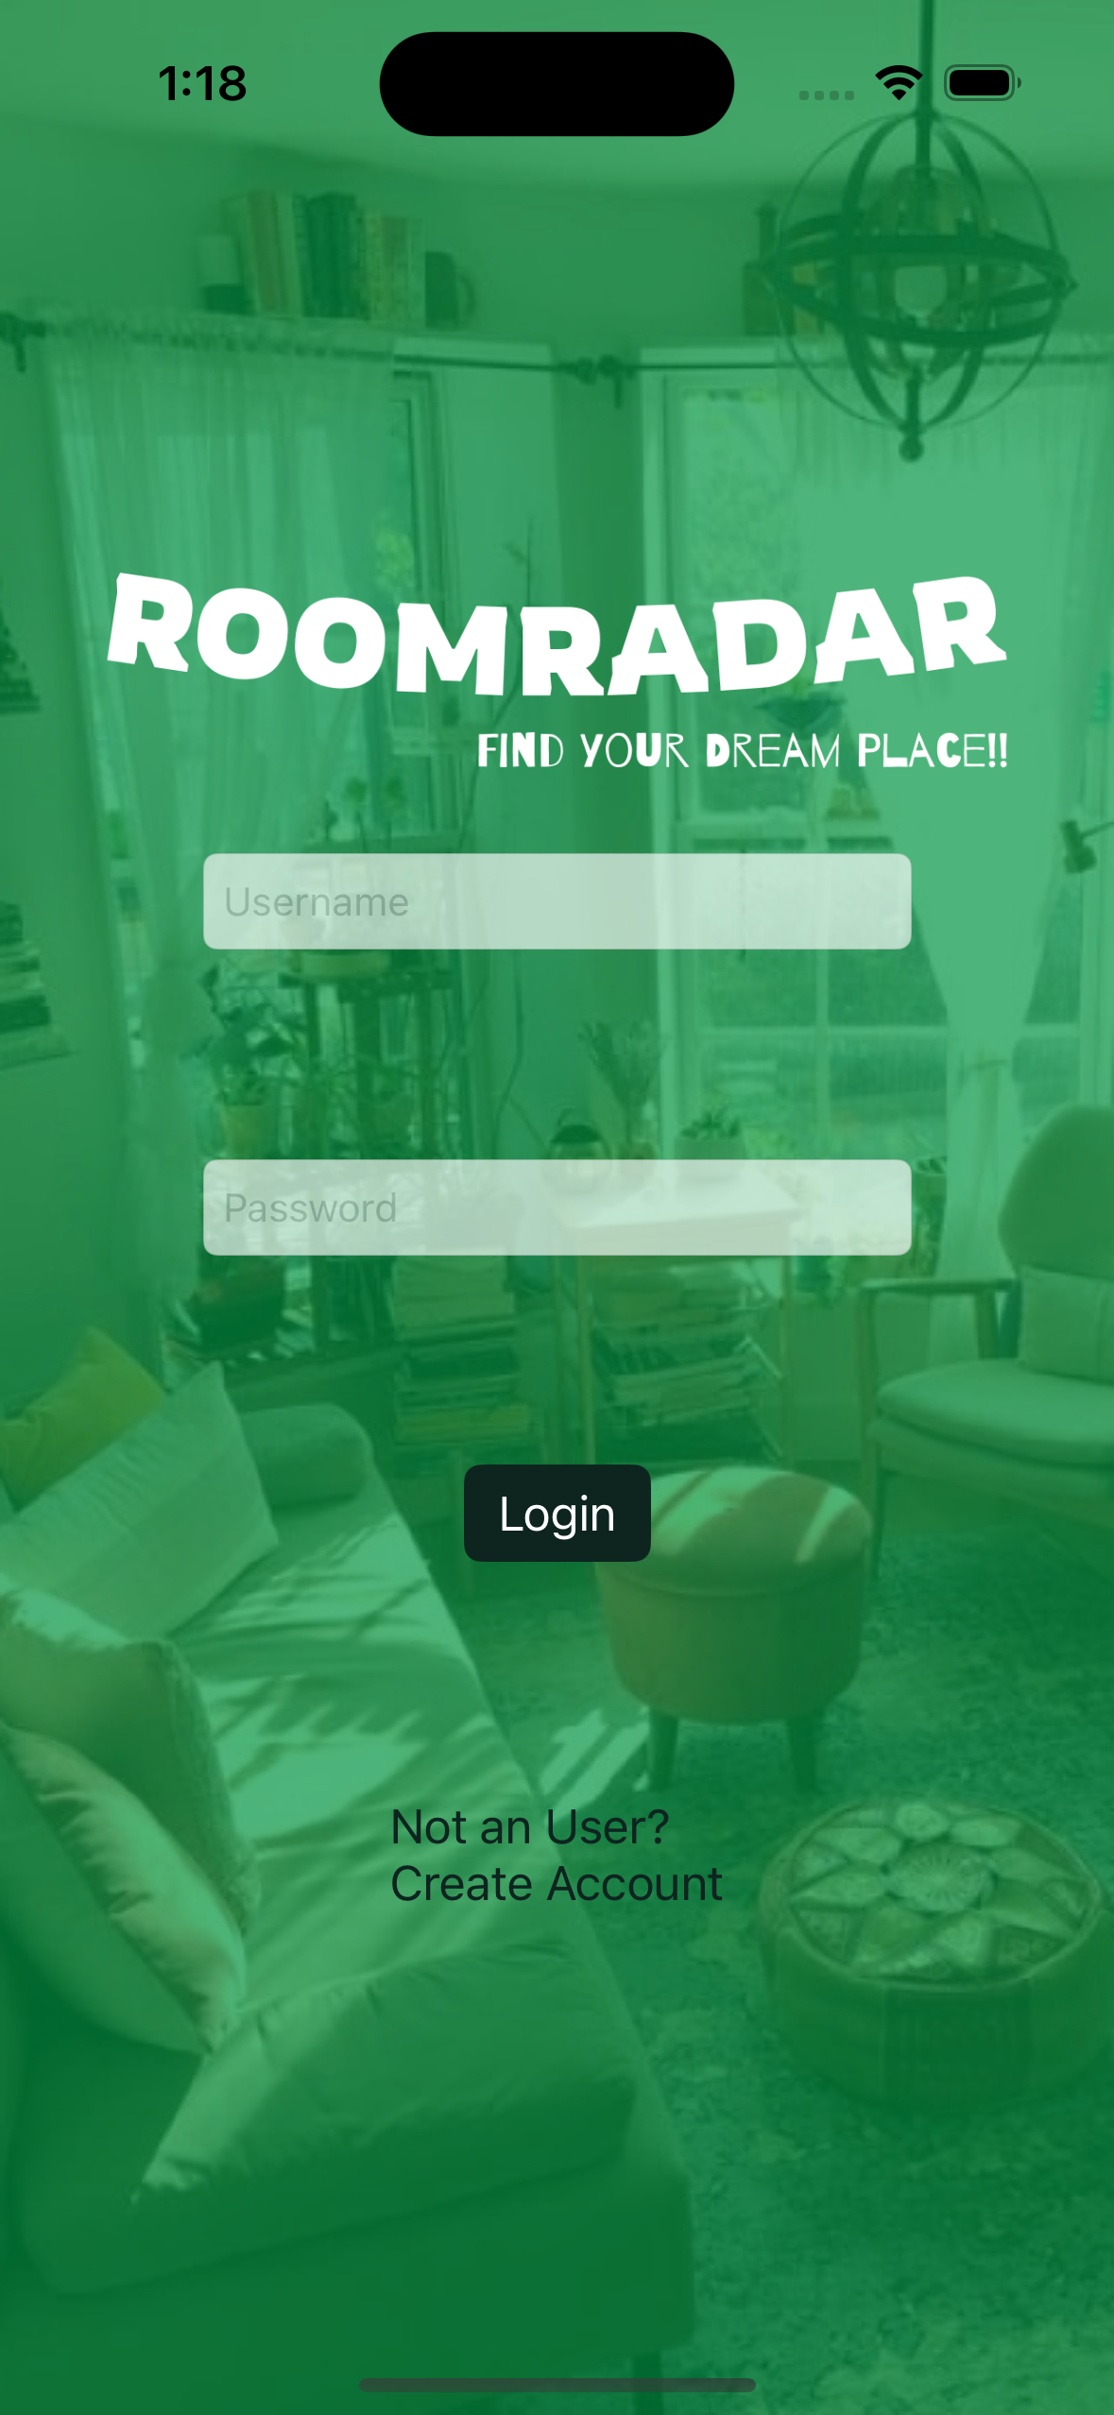
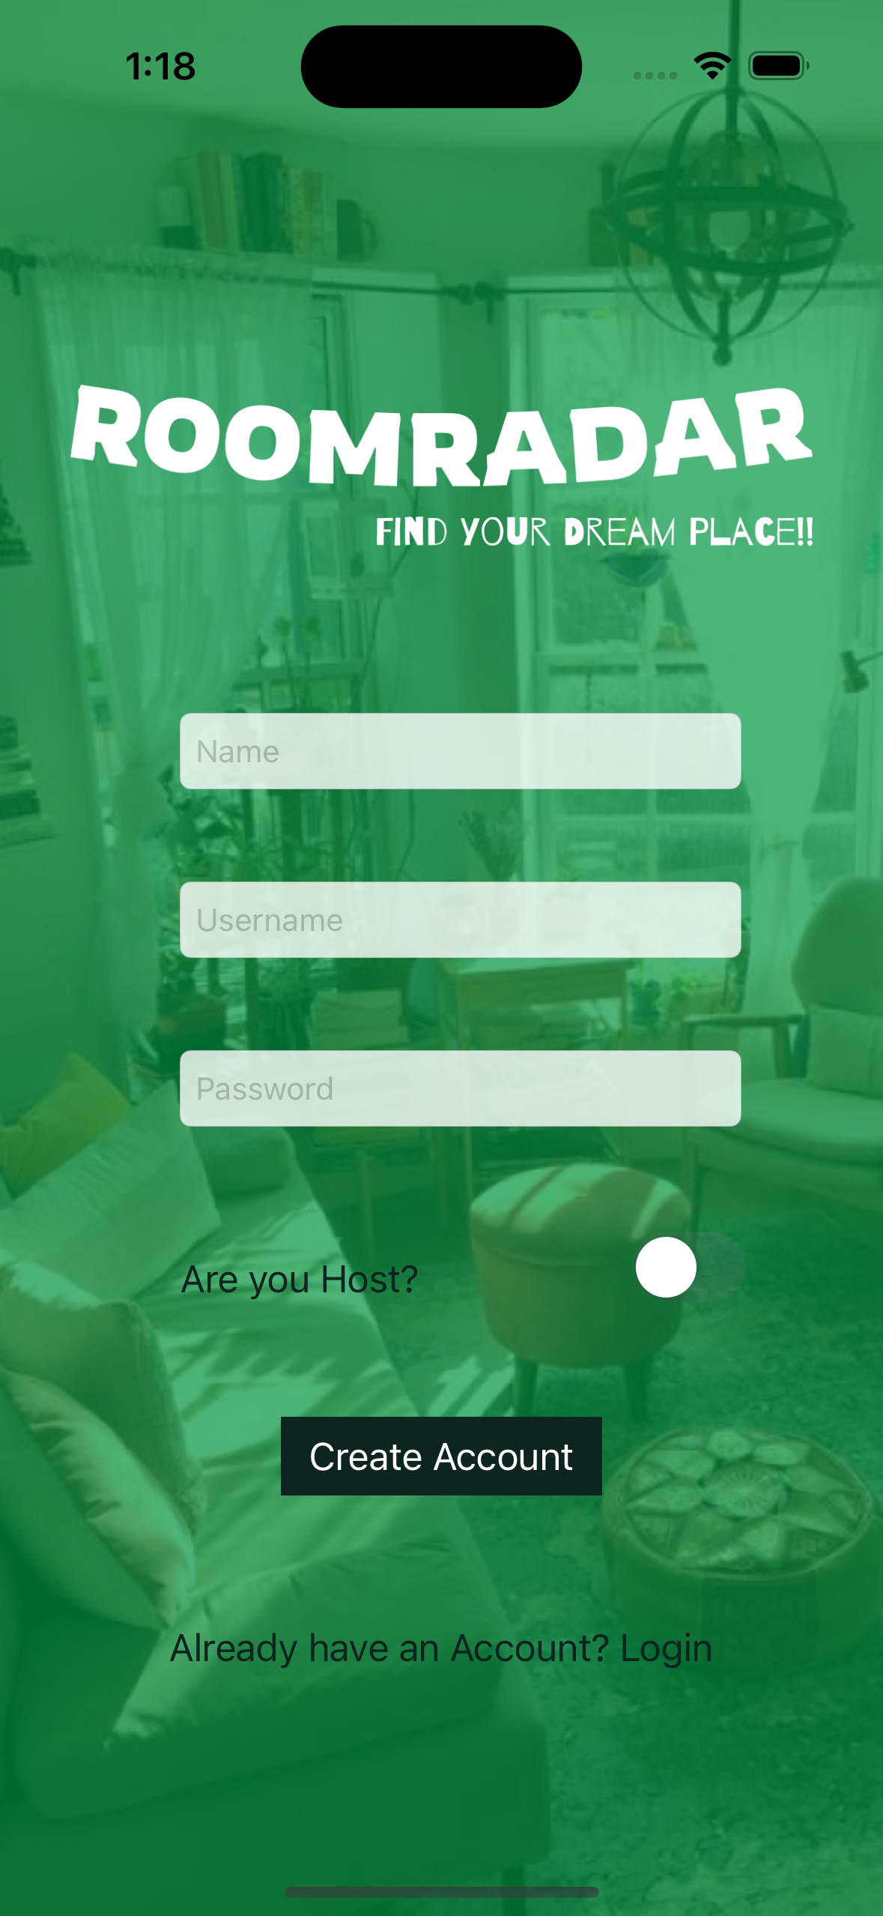
(Views) User Login & Registration

Slide 7
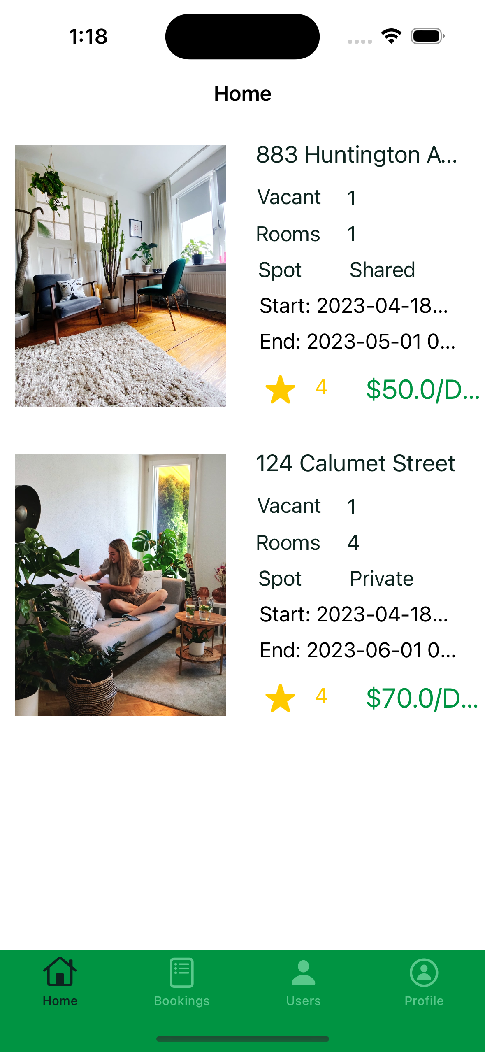
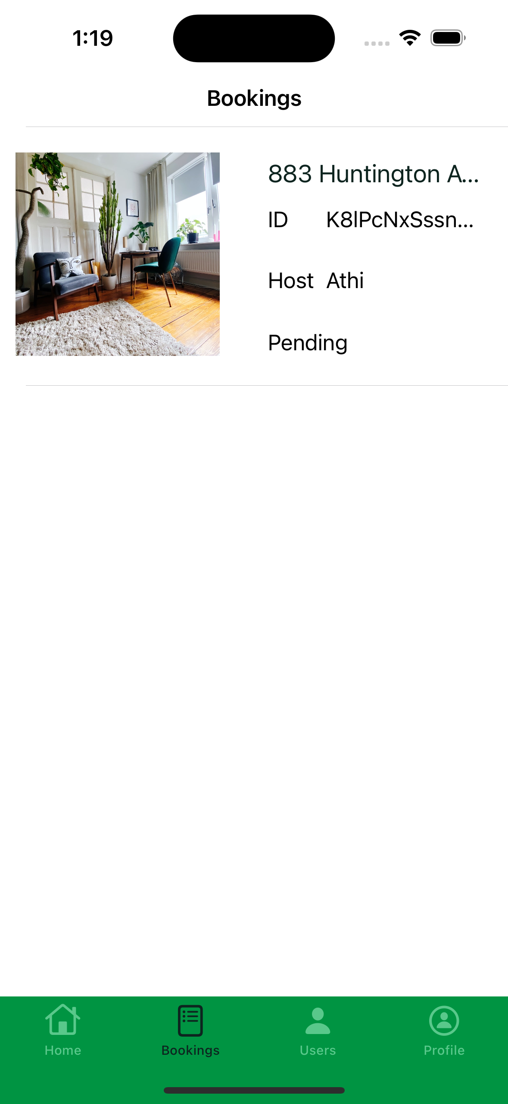
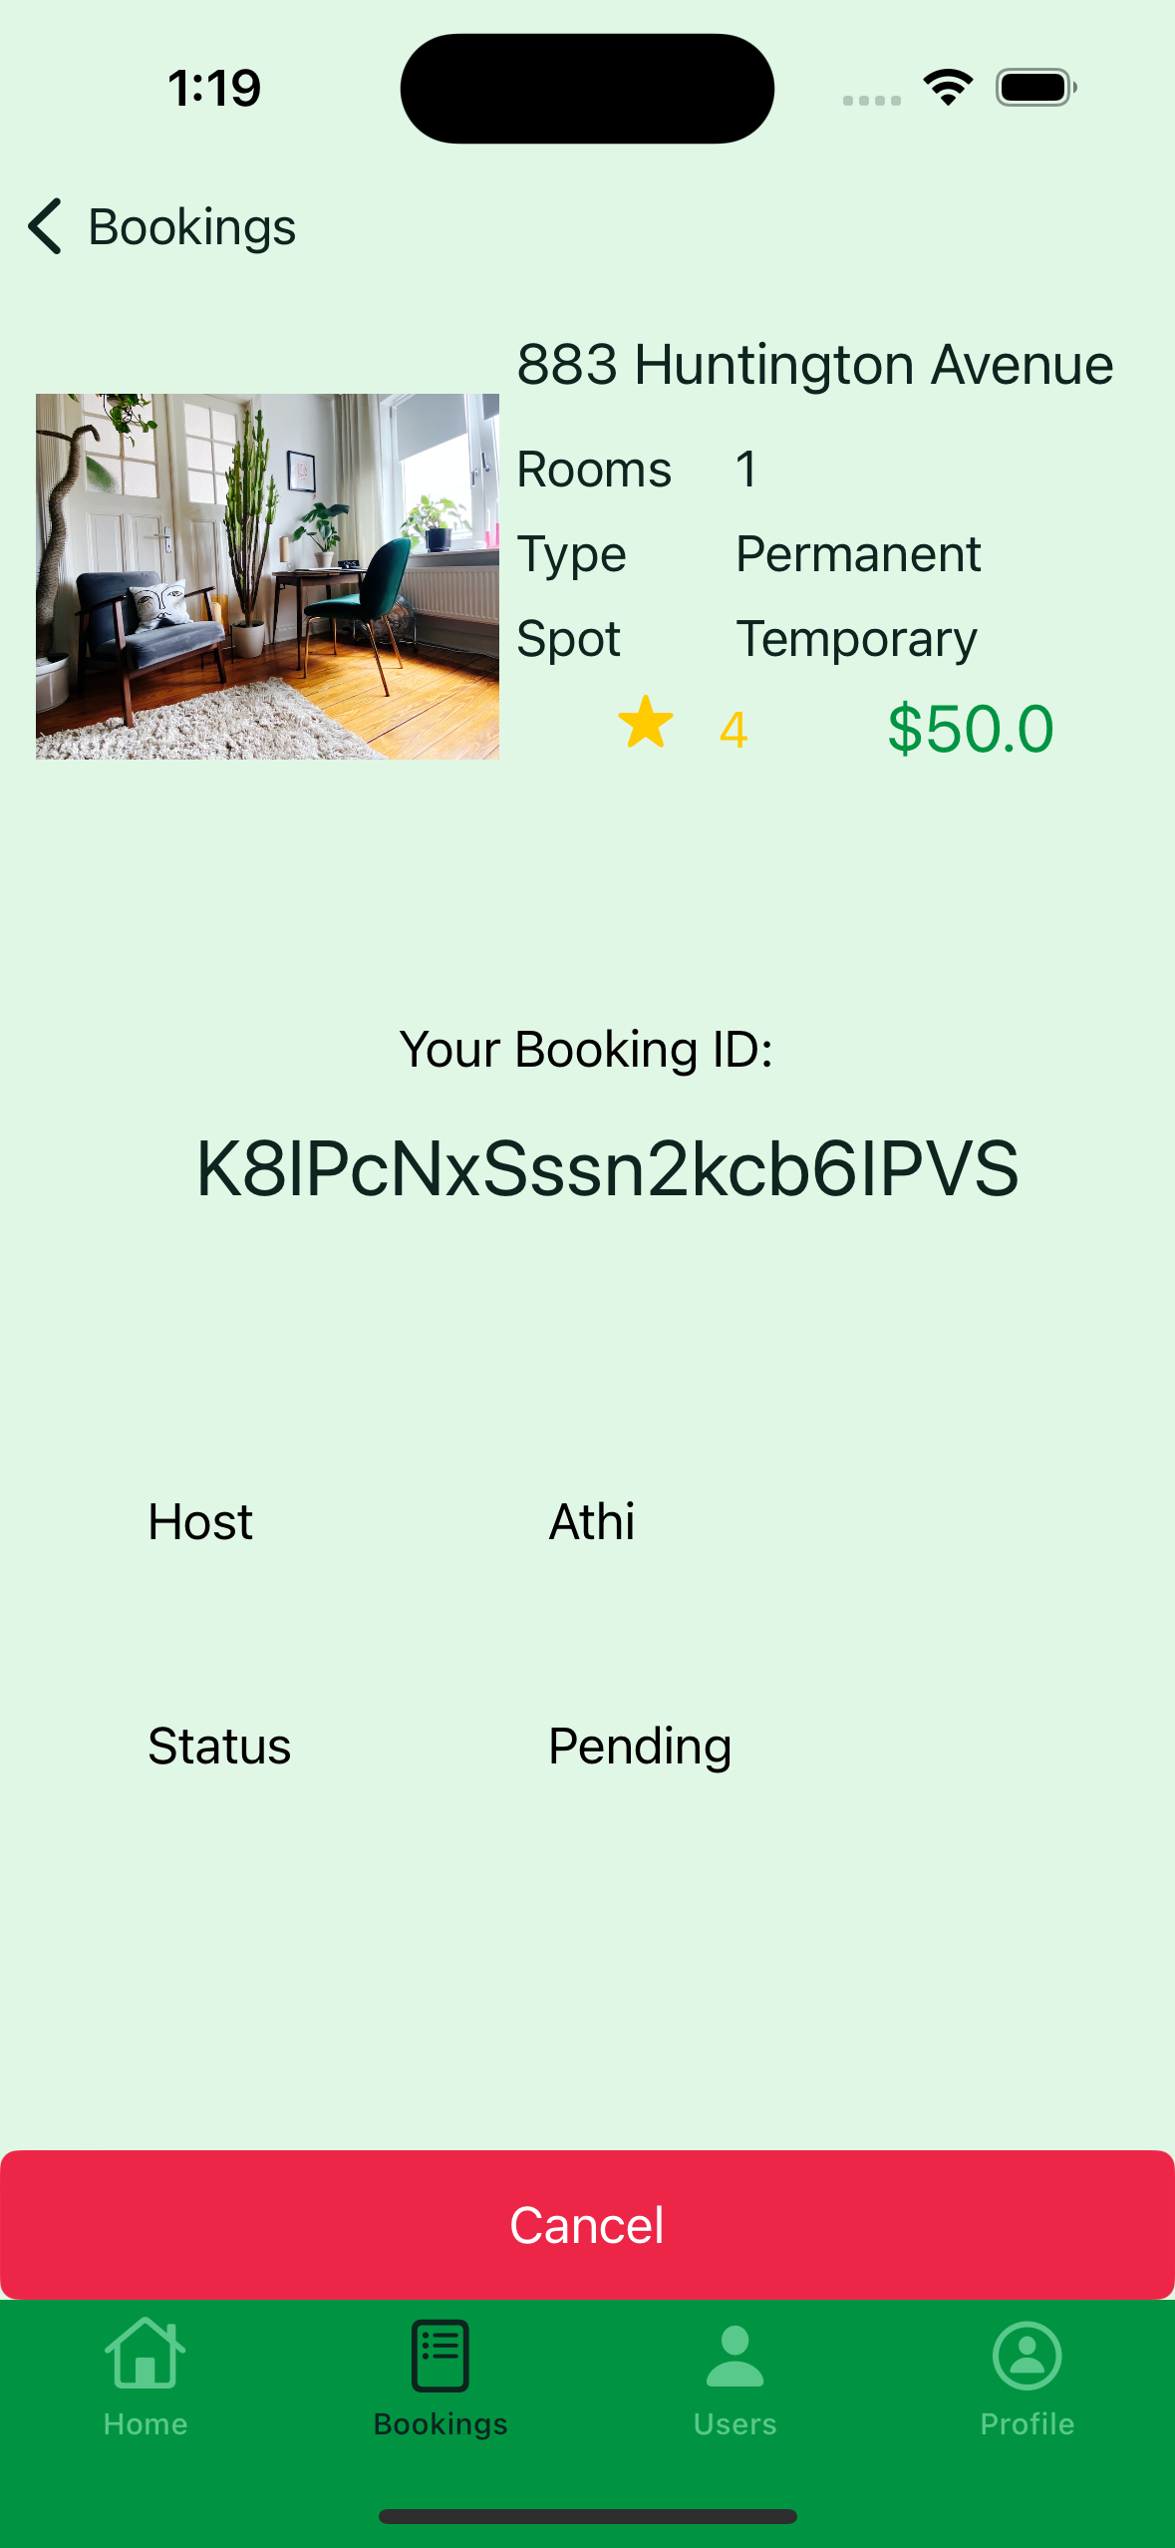
User Room Booking

Slide 8
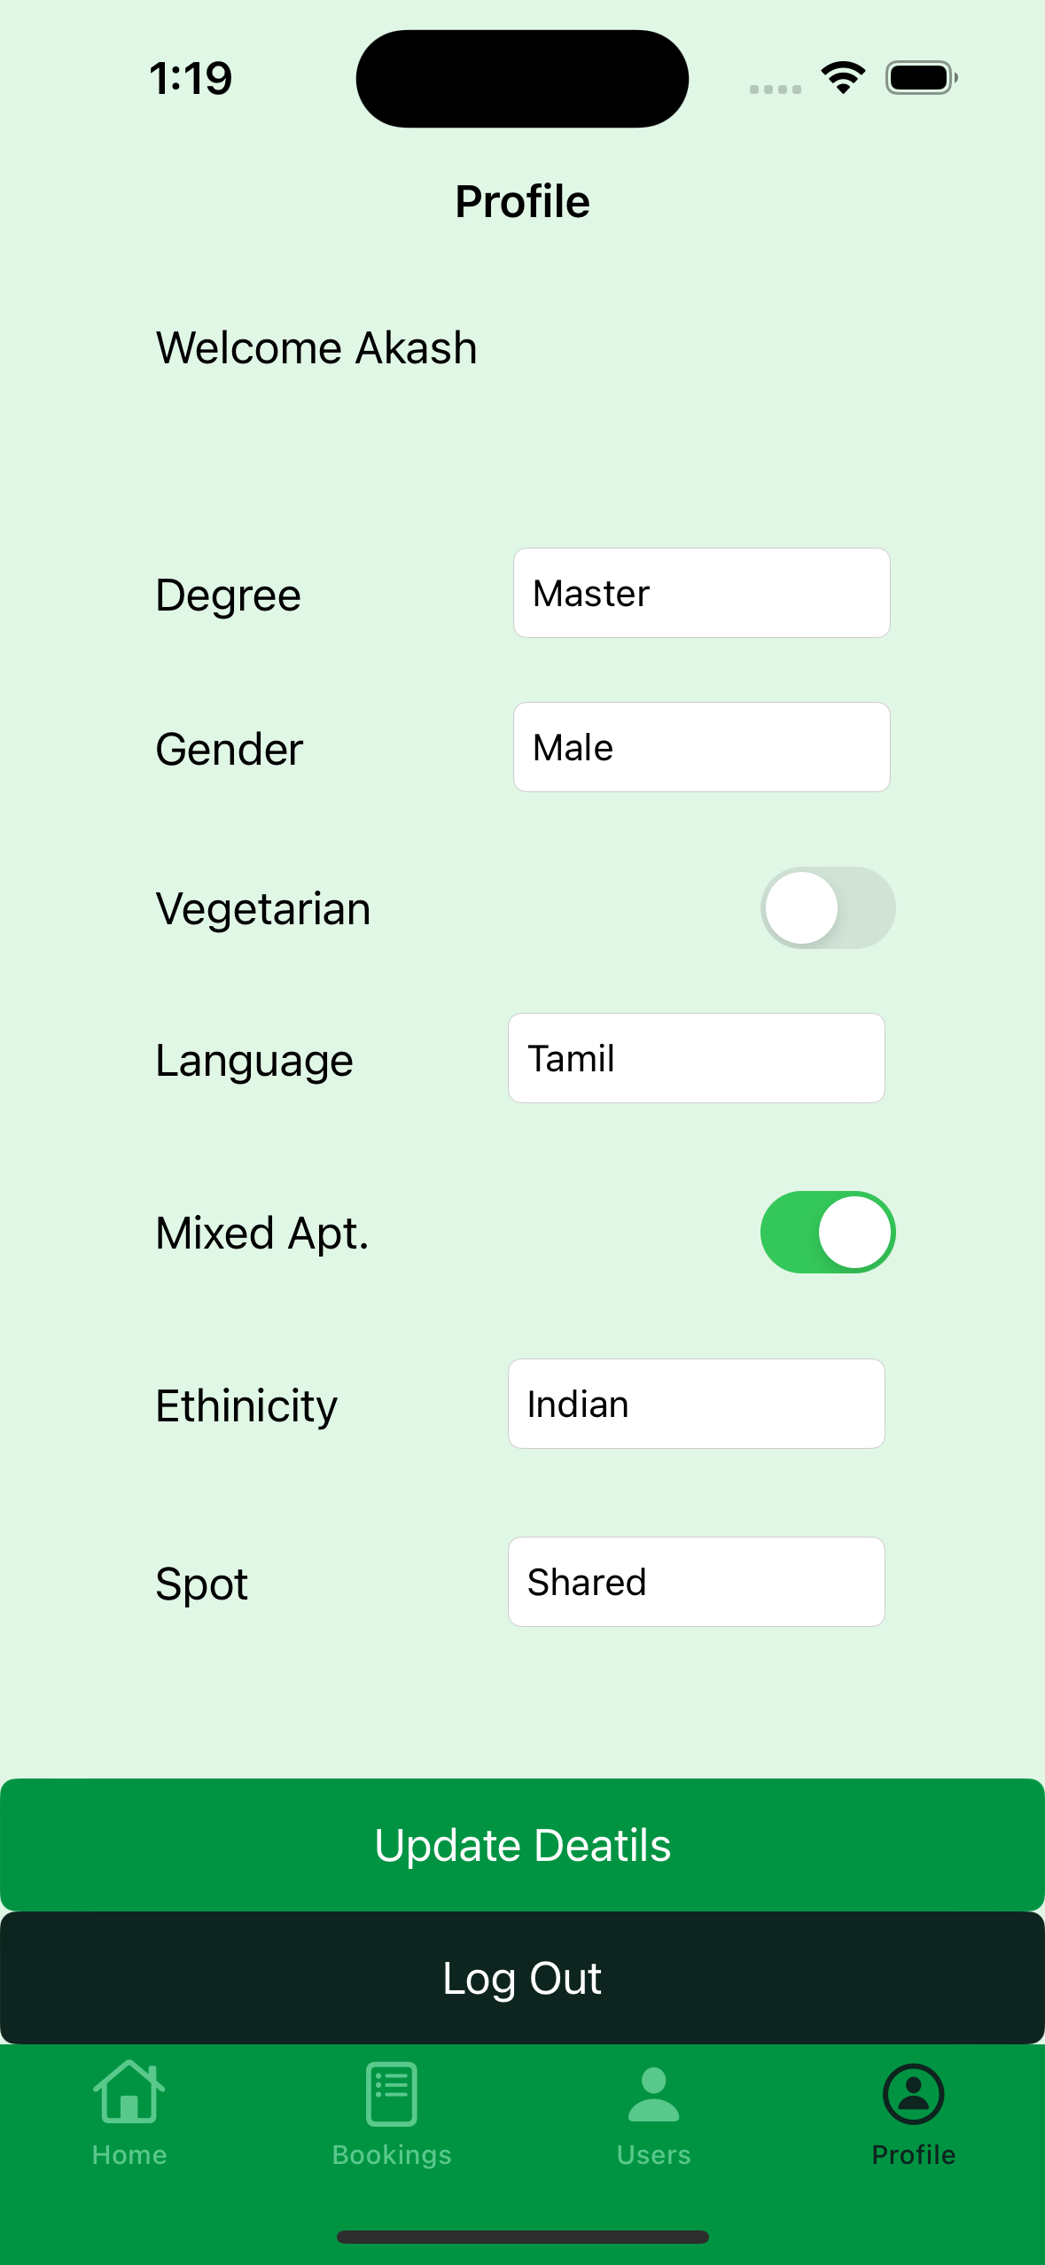
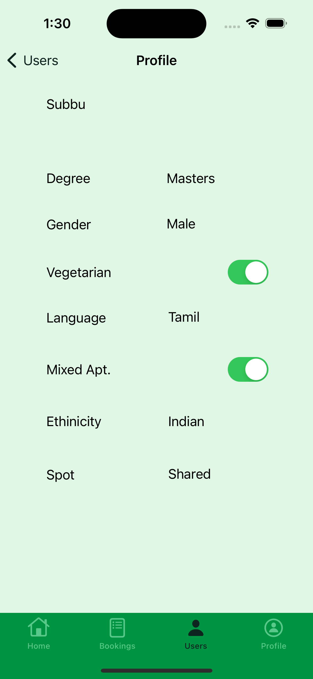
User Detail & Preferences

Slide 9
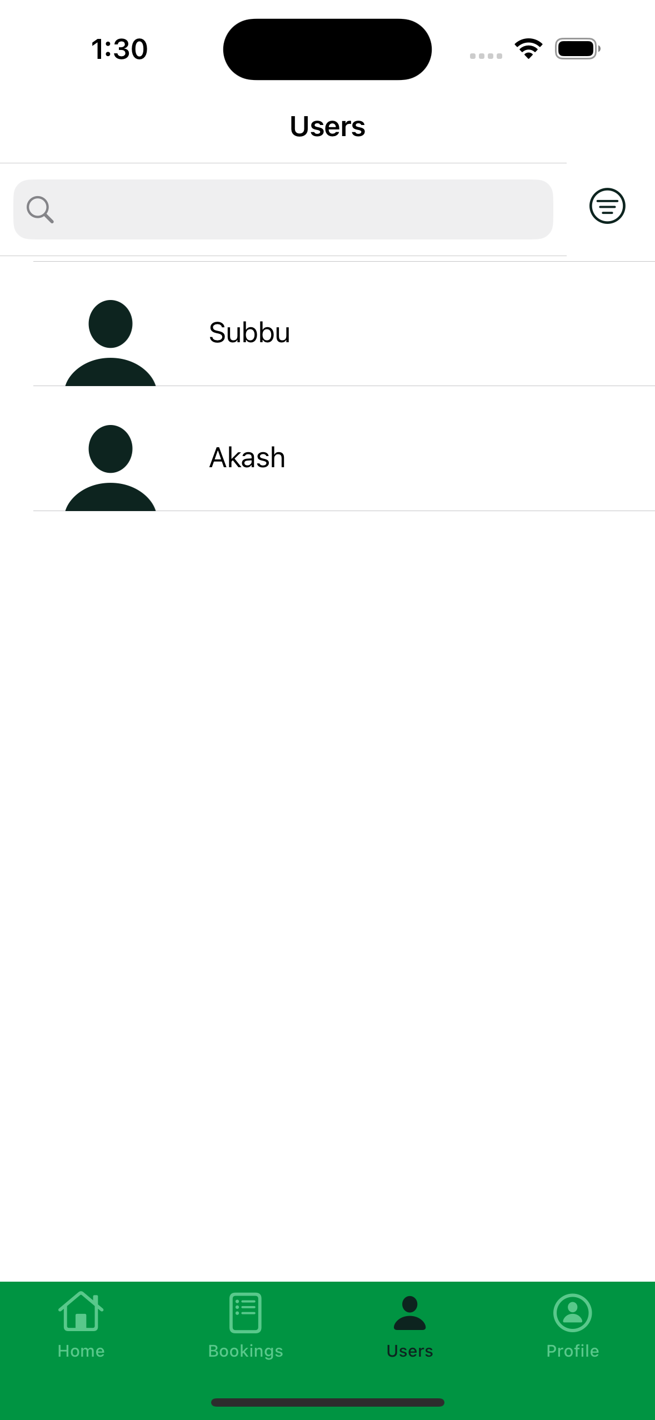
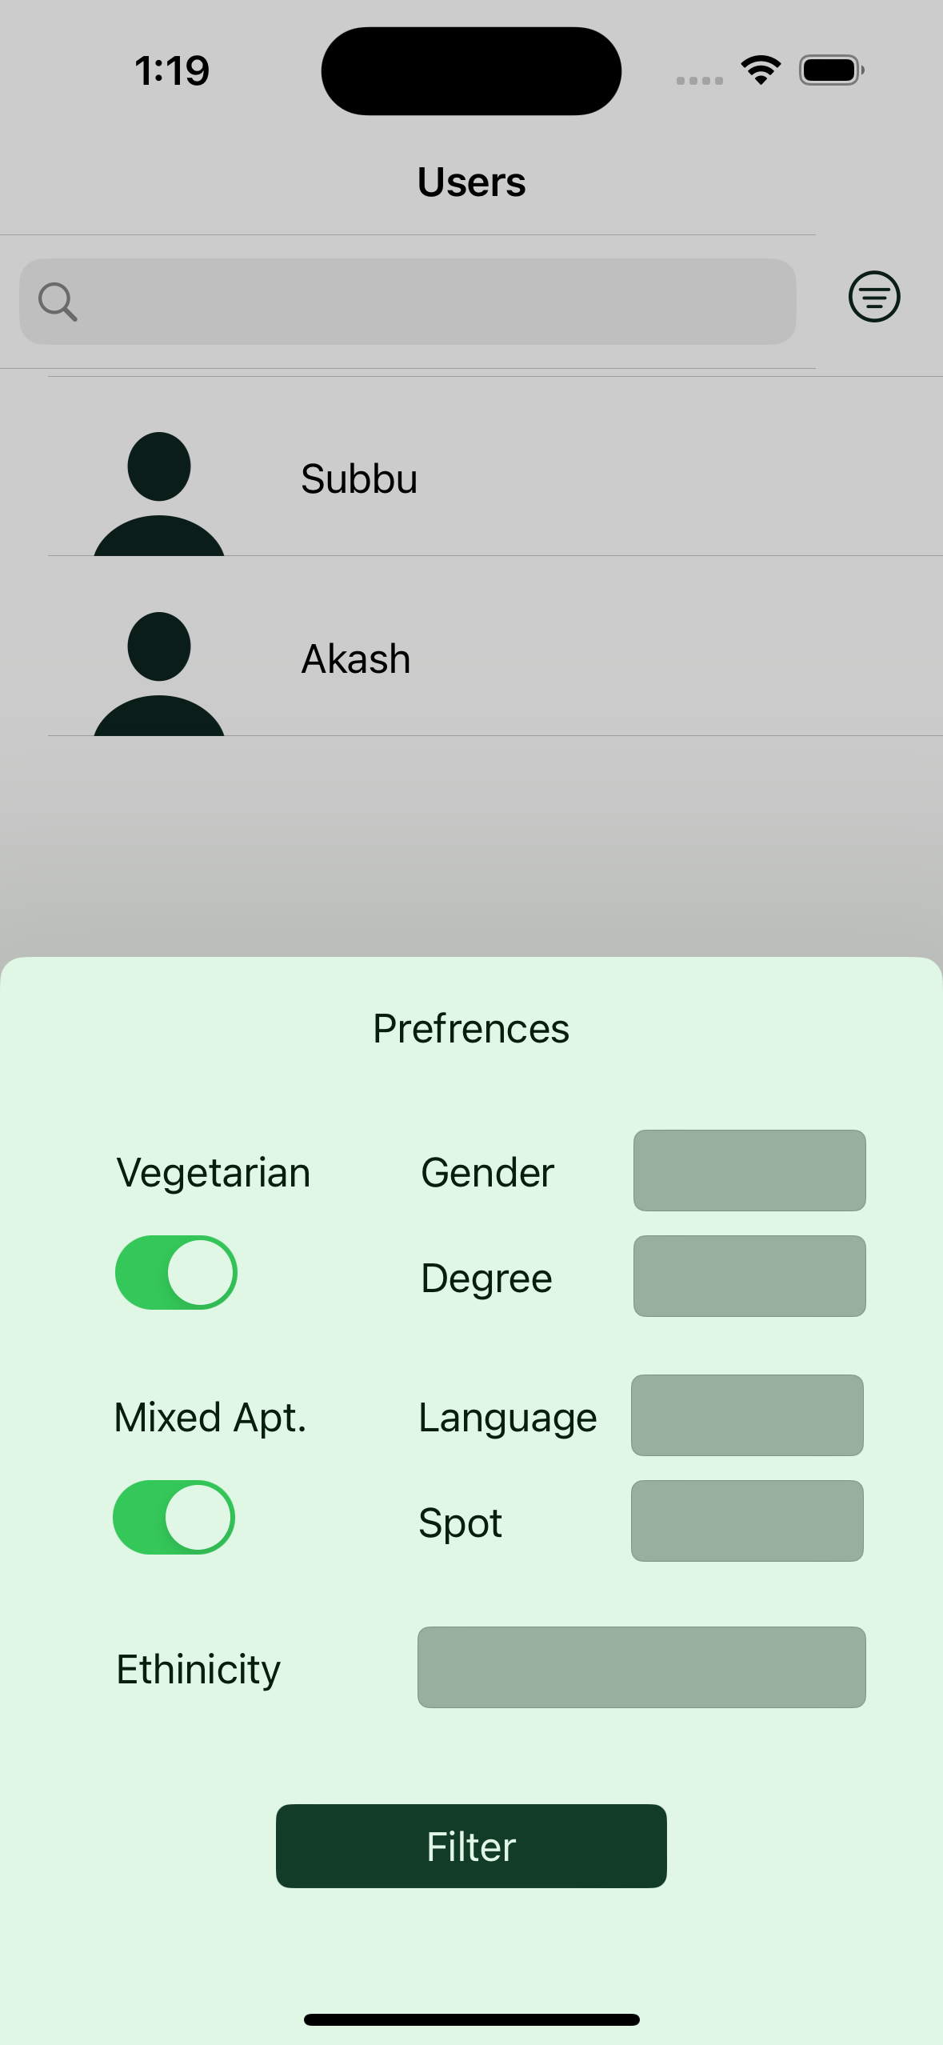
Roommate Finder

Slide 10
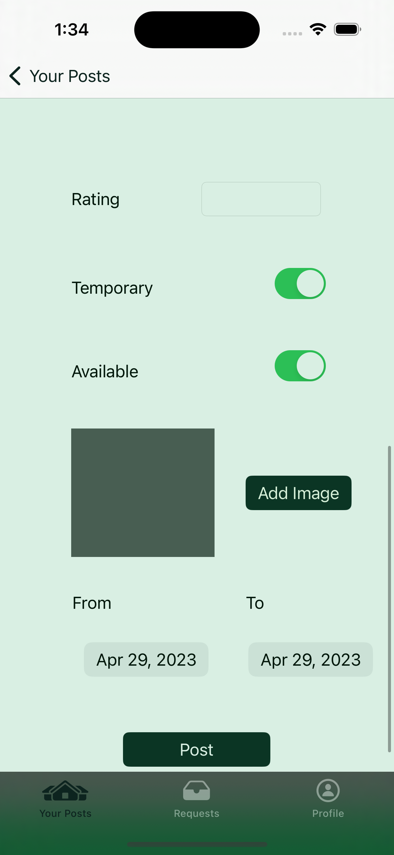
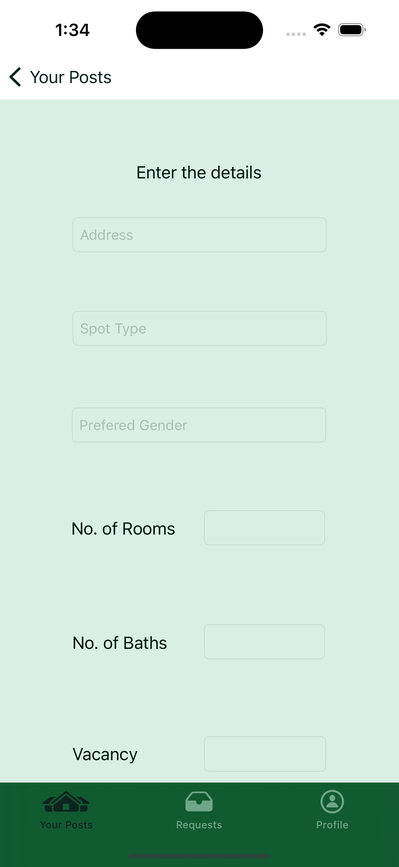
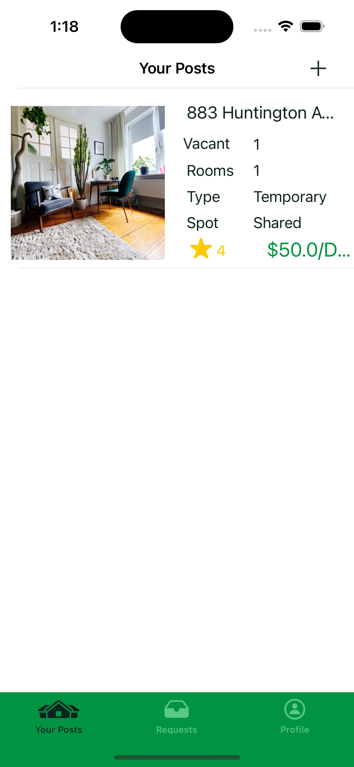
Host Create Post

Slide 11
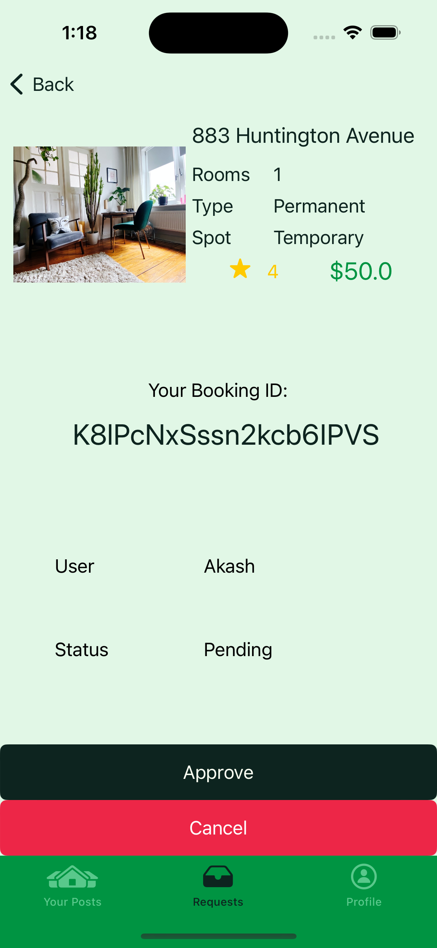
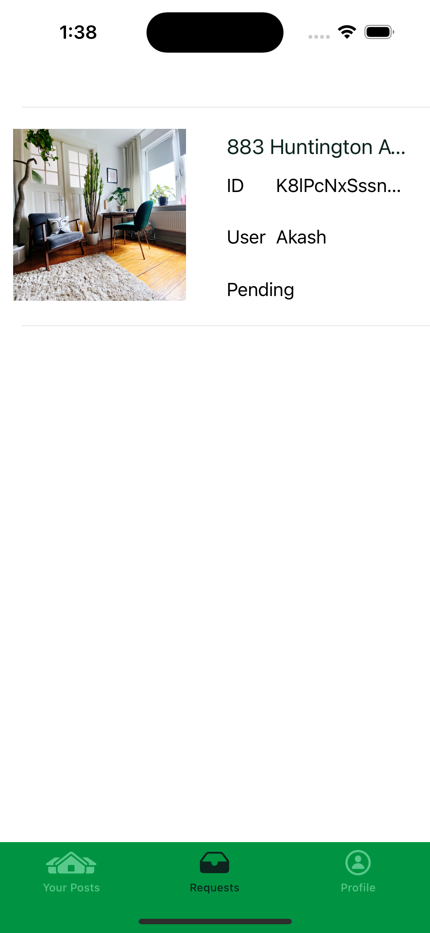
Host Booking Confirmation

Slide 12
Potential Enhancements
Create groups among users and enable chat functionality within groups.
Add a map to the app to allow users to filter rooms based on location using a radius search.
Incorporate video tours of rooms to provide a more immersive and engaging experience for users.

Slide 13
Conclusion
The app offers a centralized platform where students can easily look for and reserve housing while also promoting increased interactivity among students.
The app also has a search function that lets users narrow down results based on amenities, location, and other preferences, making the search process even more straightforward.
Overall, this software has the power to completely change the way students search for off-campus housing.

